Slide 1
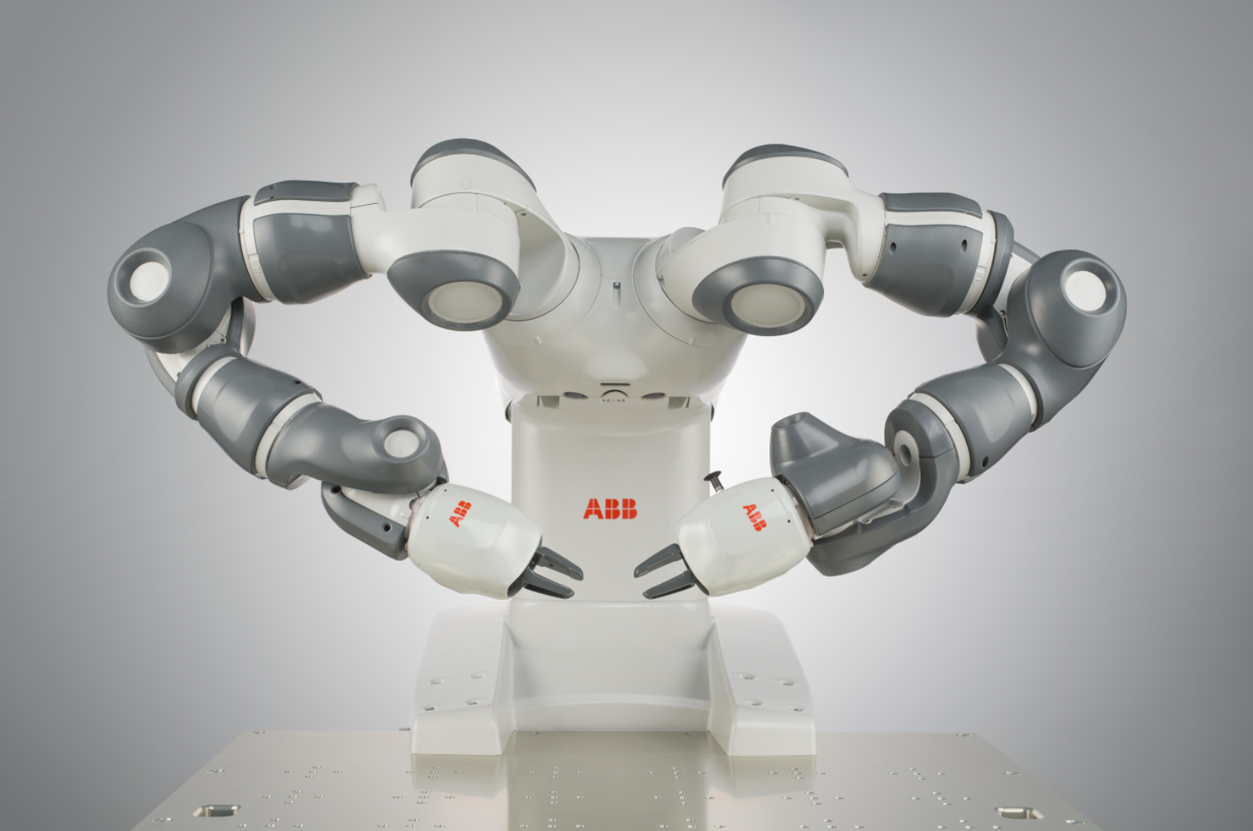
ABB YUMI ROBOT
Jatura Likitratanaporn 6013150

Slide 2
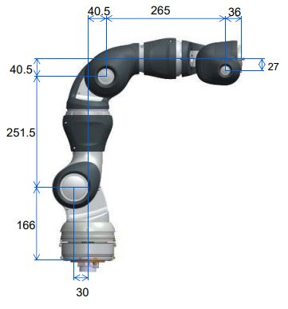
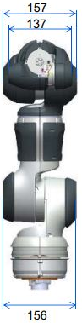
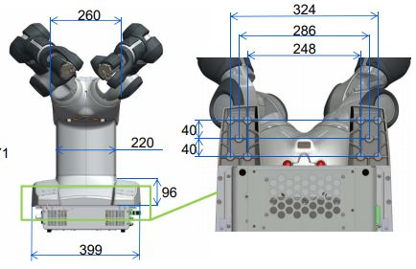
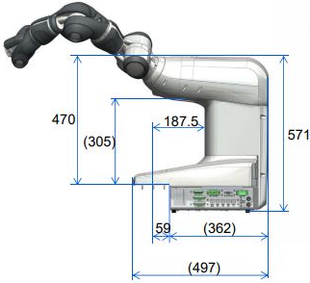
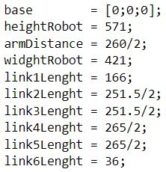
Dimensions
Code
Easy to change colors, photos and Text.
Add Text
Add Text
Add Text
You can simply impress your audience and add a unique zing and appeal to your Presentations.
Main dimensions
IRB 14000 0.5/0.5

Slide 3
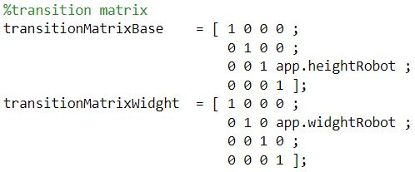
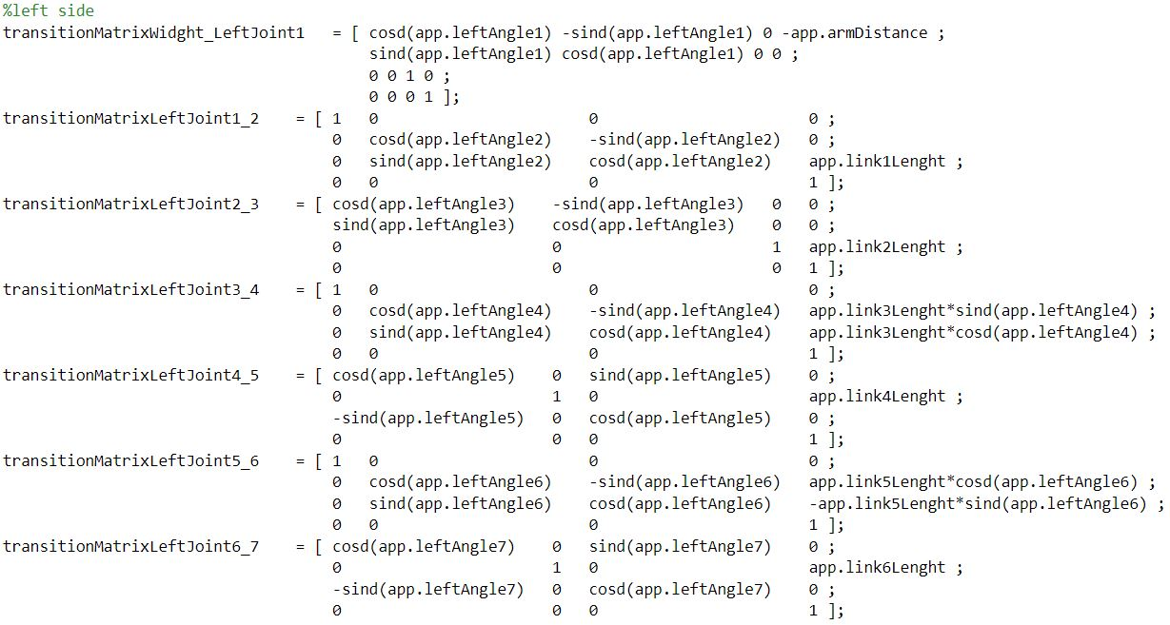
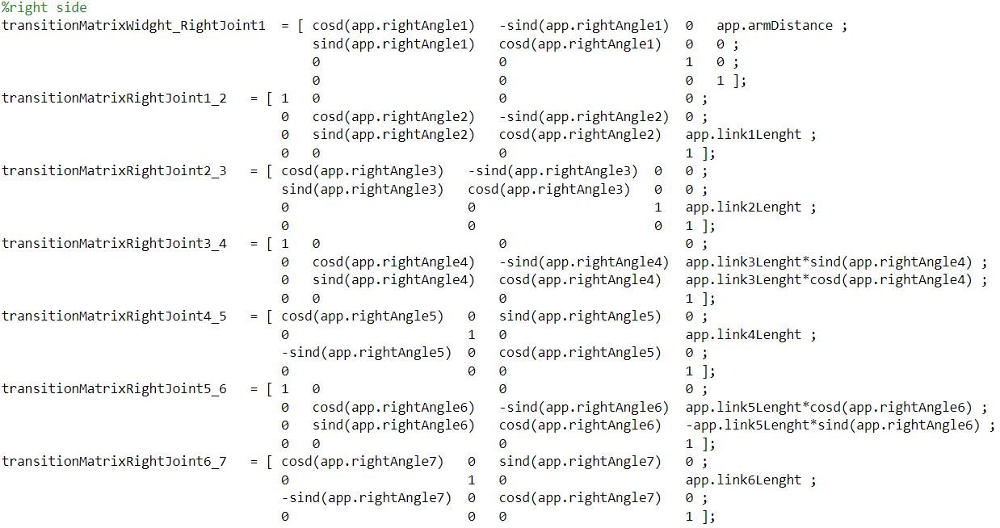
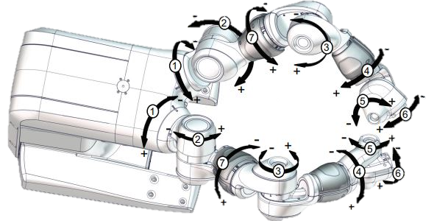
Transformation matrix
01
Content Here

Slide 4
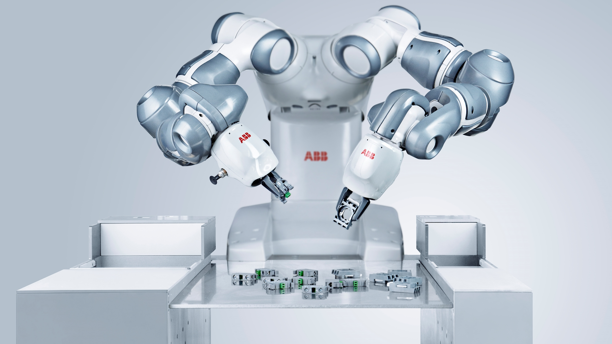
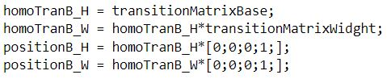
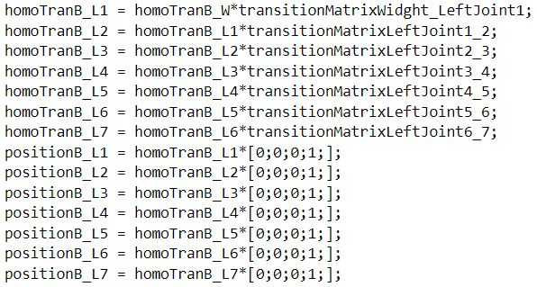
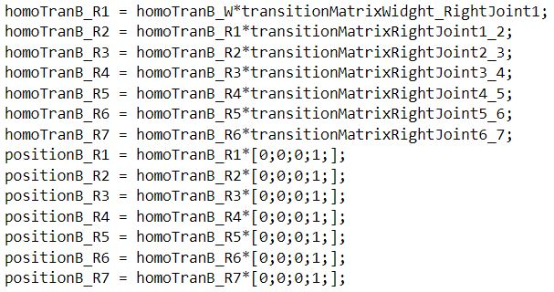
Simple Images & Contents
Get a modern PowerPoint Presentation that is beautifully designed. Easy to change colors, photos and Text.
You can simply impress your audience and add a unique zing and appeal to your Presentations. Easy to change colors, photos and Text. Get a modern PowerPoint Presentation that is beautifully designed. I hope and I believe that this Template will your Time, Money and Reputation. You can simply impress your audience and add a unique zing and appeal to your Presentations.

Slide 5
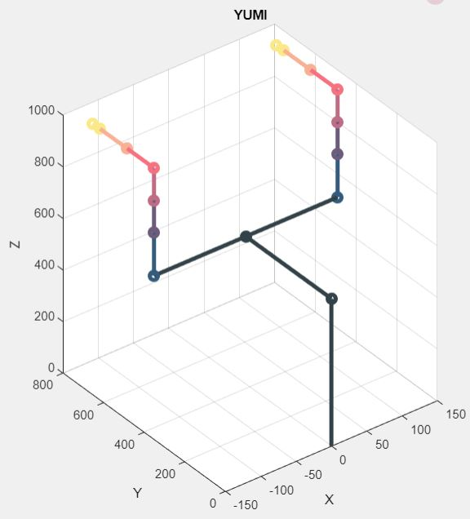
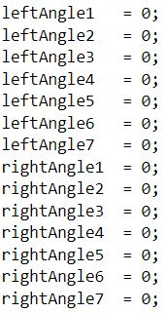
Plot initial robot
Modern PowerPoint Presentation
NO.1 Presentation
Content Here
You can simply impress your audience and add a unique zing and appeal to your Presentations. Easy to change colors, photos and Text.
Simple PowerPoint Presentation
Easy to change colors, photos and Text.
Easy to change colors, photos and Text.

Slide 6
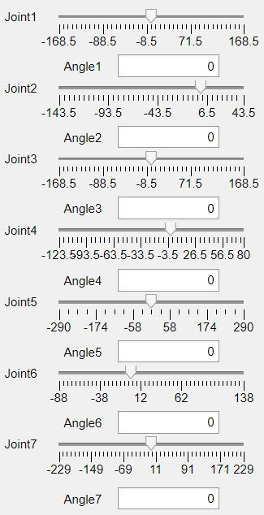
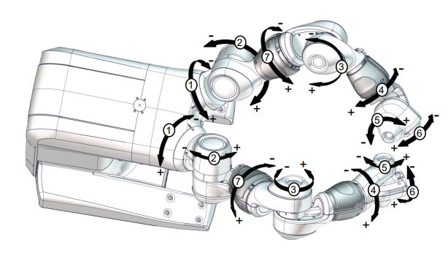
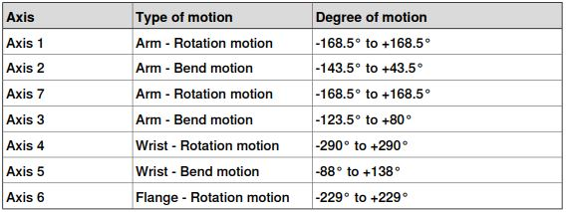
Motion range
Set maximum angle that user can input from degree of motion
Content Here
Content Here

Slide 7
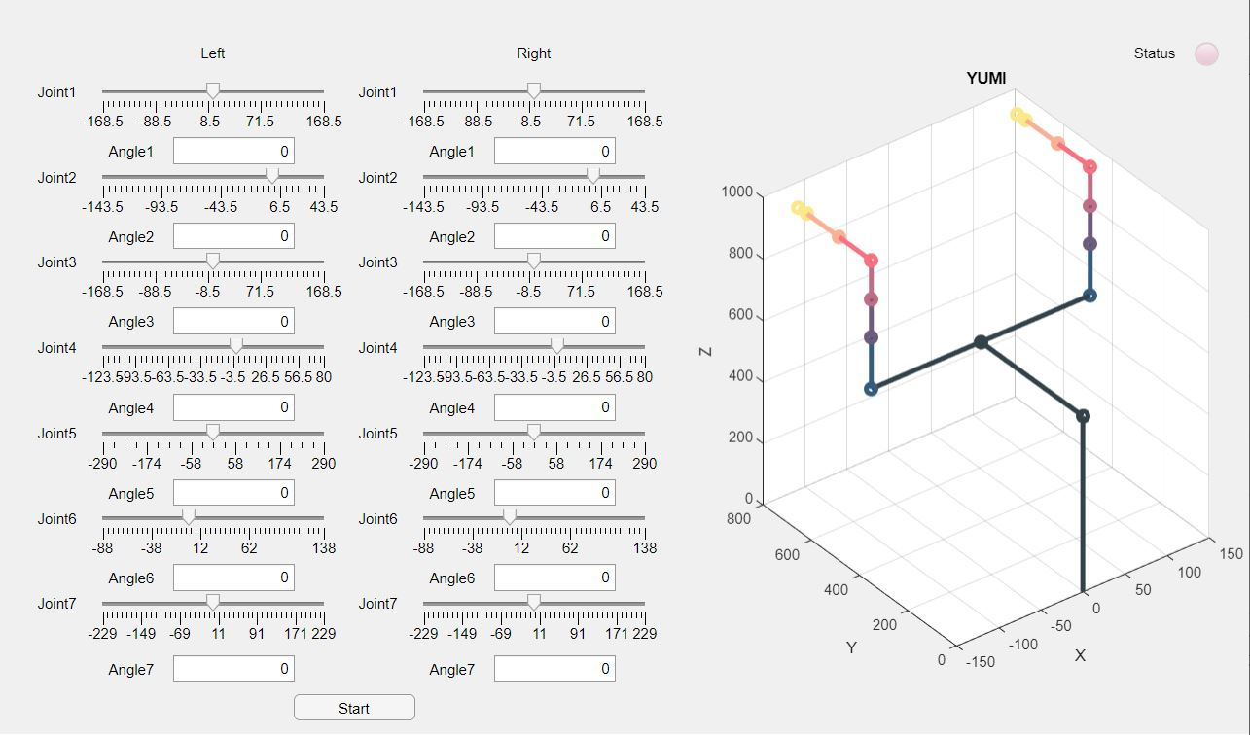
User interface

Slide 8
User interface
Status lamp
Degree input of each angle
Motion of YUMI
Start button

Slide 9
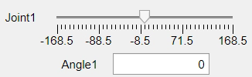


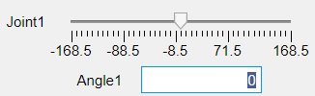
Input degree
Slider bar
Edit numeric field

Slide 10



Status lamp
01
Initial status lamp
02
Processing status lamp
03
Finishing status lamp

Slide 11
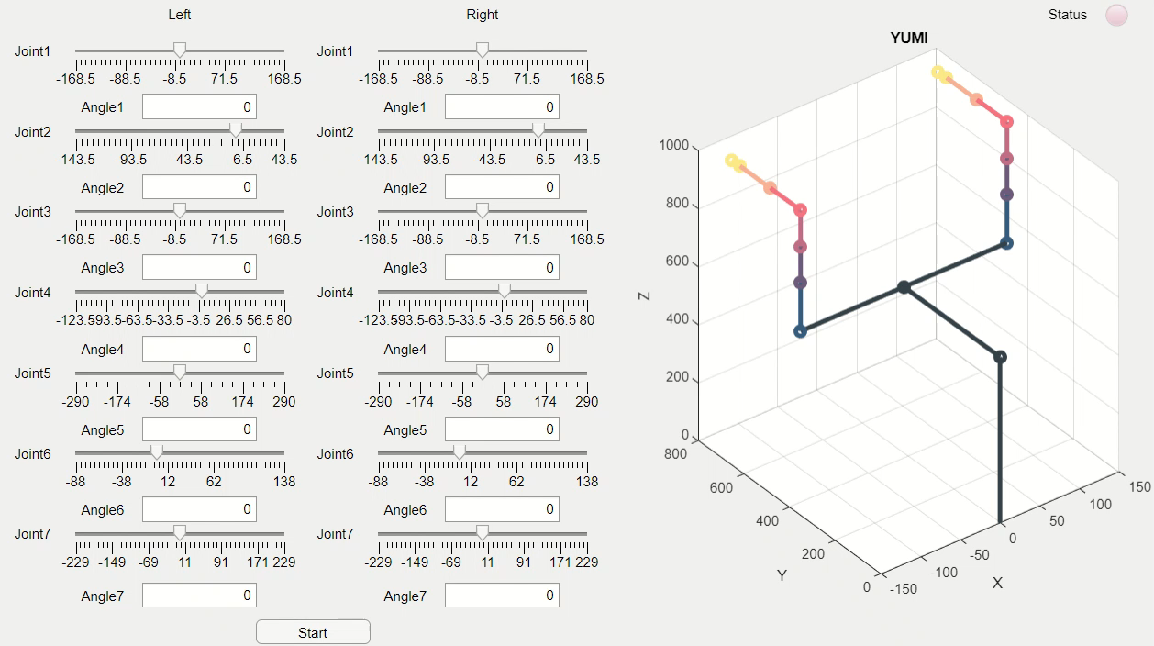

Slide 12
